Slide 1


Detection of Malicious URLs Using Machine Learning
Enhancing cybersecurity through AI-powered detection of malicious URLs, addressing the growing threat of phishing scams and their significant financial impact.
C
Student Name: SZE CHI KEUNG (SAUL)
Student ID: 20161536

Slide 2

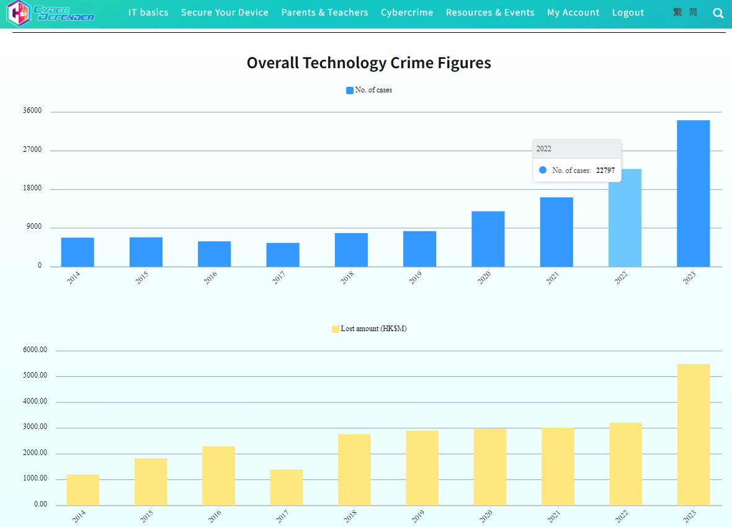


Project Background
Increased 33% from 2022 to 2023
Lost 5 million in 2023
Source from CyberDefender of Hong Kong Police Force

Slide 3

Project Overview
1
Effective URL Scanning System
2
Leverage ML Algorithms
3
Discord Integration
Develop an advanced URL scanning system to enhance cybersecurity.
Utilize C4.5, Random Forest, and Support Vector Machine algorithms.
Integrate the system with Discord for real-time URL detection.
Reduce losing money
Keep personal data safe
Raise public awareness about fraud and how to avoid it

Slide 4
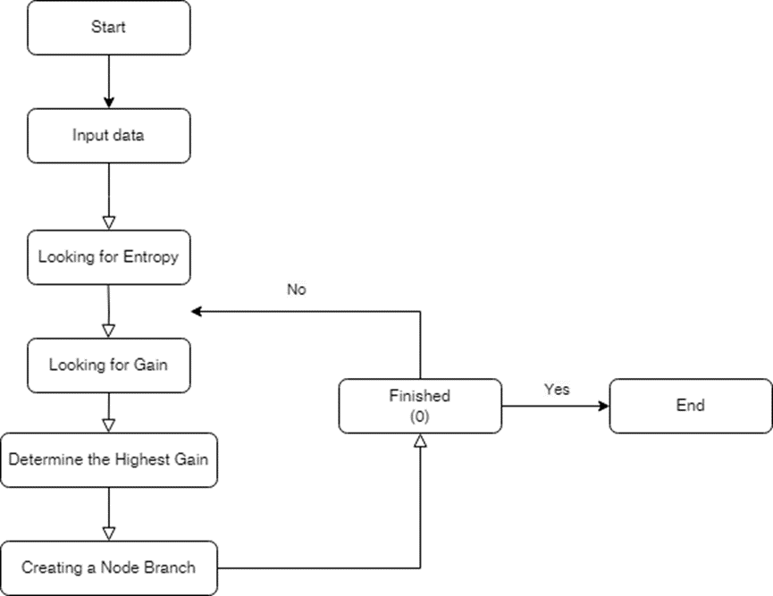
C4.5 Algorithm
1
Concept
Extension of the ID3 algorithm, creating a decision tree based on information gain.
2
Process
Calculate entropy, determine information gain, and split the data iteratively.
3
Strengths
Handles categorical and numerical data, produces easily interpretable rules.

Slide 5
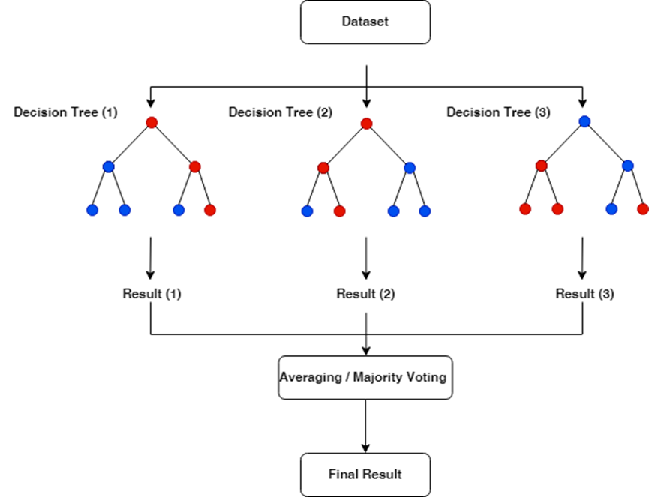
Random Forest Algorithm
1
Concept
Ensemble method using multiple decision trees, reducing overfitting.
2
Process
Generate bootstrap samples, build decision trees, and combine results through voting.
3
Strengths
Handles large datasets with higher accuracy, reduces variance and overfitting.

Slide 6
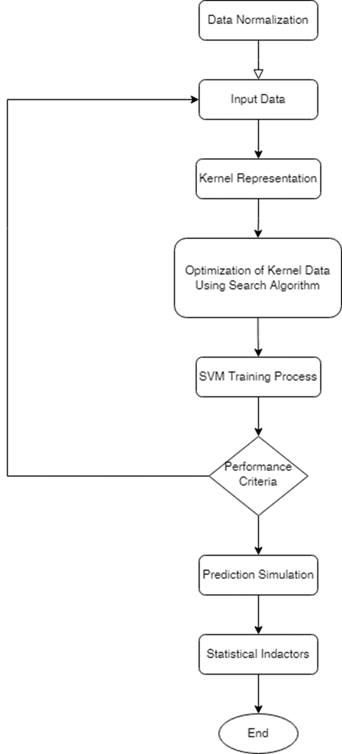
Support Vector Machine (SVM)
Concept
1
Finds the optimal hyperplane that maximizes the margin between classes, using kernel functions.
2
Process
Normalize data, select a kernel function, optimize parameters, and train the model.
Strengths
3
Effective in high-dimensional spaces, robust to overfitting with proper tuning.

Slide 7

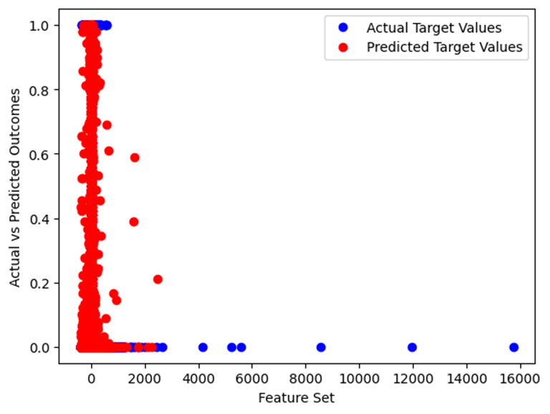


Model Training and Evaluation
Data Preprocessing
Normalize the data and select relevant features.
Model Training
Split the data into training and testing sets, then train the models.
Performance Evaluation
Assess the models using accuracy, precision, recall, and F1 score.

Slide 8

Integration with Discord Bot
User Interaction
Simple commands for users to check URLs, with immediate results based on AI and VirusTotal analysis.

Slide 9
Comparative Analysis with 300 malicious URLs
Comparison
VirusTotal
C4.5
Random Forest
SVM
Accuracy
Moderate
High but risk of overfitting
Good generalization
Poor performance
Precision
Moderate
High
High
Low
False Positives/Negatives
Moderate
Low
Low
Low

Slide 10
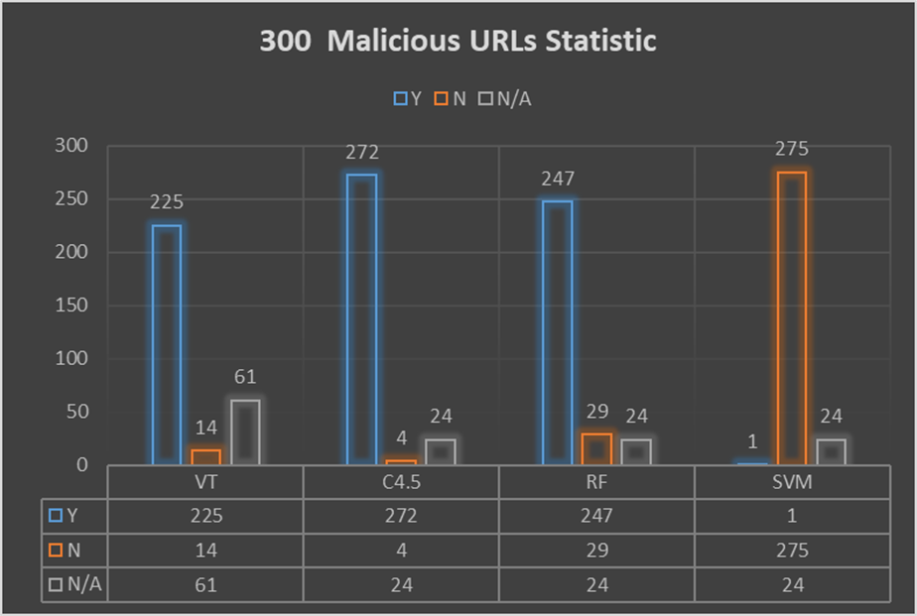
Comparative Analysis with 300 malicious URLs

Slide 11



Challenges and Solutions
Challenges
Feature selection limitations (e.g. script_percentage)
Data overload for SVM
Solutions
Focus on extractable features (e.g. count_domain_occurrences)
Reduce dataset size

Slide 12
Summary
AI-based detection significantly improves cybersecurity
The combination of C4.5 and RF provides strong protection
Virustotal’s performance is not bad as free open sources, AI
Detection is another good choice

Slide 13
End
Q&A

